Slide 1
Benchmark 5 – Product 4: Student artifacts

Slide 2
Congratulations top 20 class of 2023 *18 of the top 20 students were t-stem students*

Slide 3
Donna North health science students attended the UTRGV 2022 Research Symposium 2022- International Conference of Health Disparities: Treatment and Recovery from Opiod and Alcohol Use Disorders and Related Comorbidities as well as Understanding the Mechanisms of the UBTFE210K Neuroregression syndrome. 2022-2023

Slide 4
our Criminal Justice students help our Donna ISD Police Department direct traffic before the football games. This is an excellent opportunity for our students to gain practical knowledge about the duties of law enforcement officers in a school district environment. 2022-2023

Slide 5
We want to thank and Welcome Home RGV & the City of McAllen TX Government for allowing our Health Science students to attend the Winter Texan Expo & Health Fair at the McAllen Convention Center. The students learned from The Medicare Store SkyMed, Valley Regional Medical Center, Mission Regional Medical Center, and other medical professionals about basic medical tests, screenings, and vaccines. 2022-2023

Slide 6
our Health Science students attend the Greater Mission Chamber of Commerce Community Health Fair at the Mission Event Center. The students learned from medical professionals about basic medical tests, screenings, and vaccines. These opportunities allow our students to learn and identify community healthcare resources and learn from medical professionals in our region. 2022-2023

Slide 7
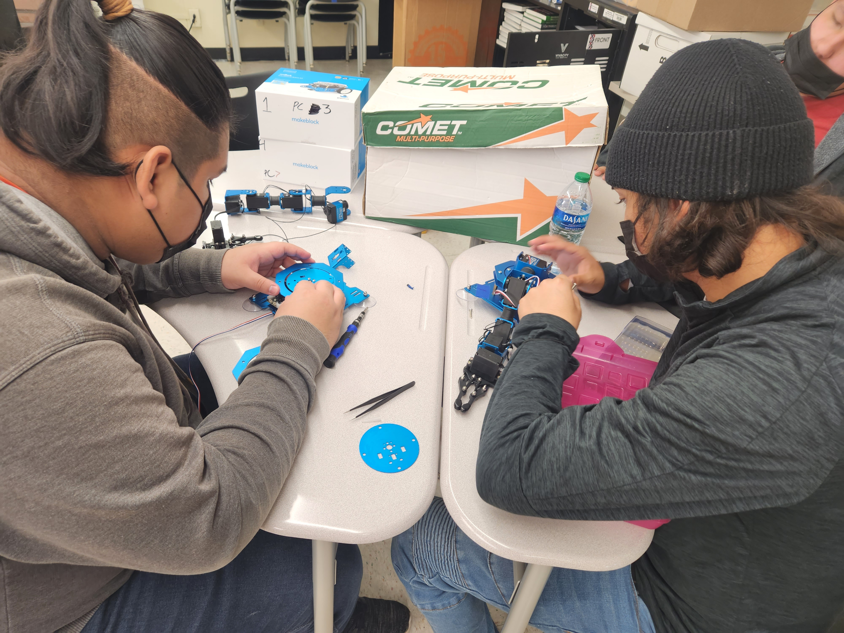
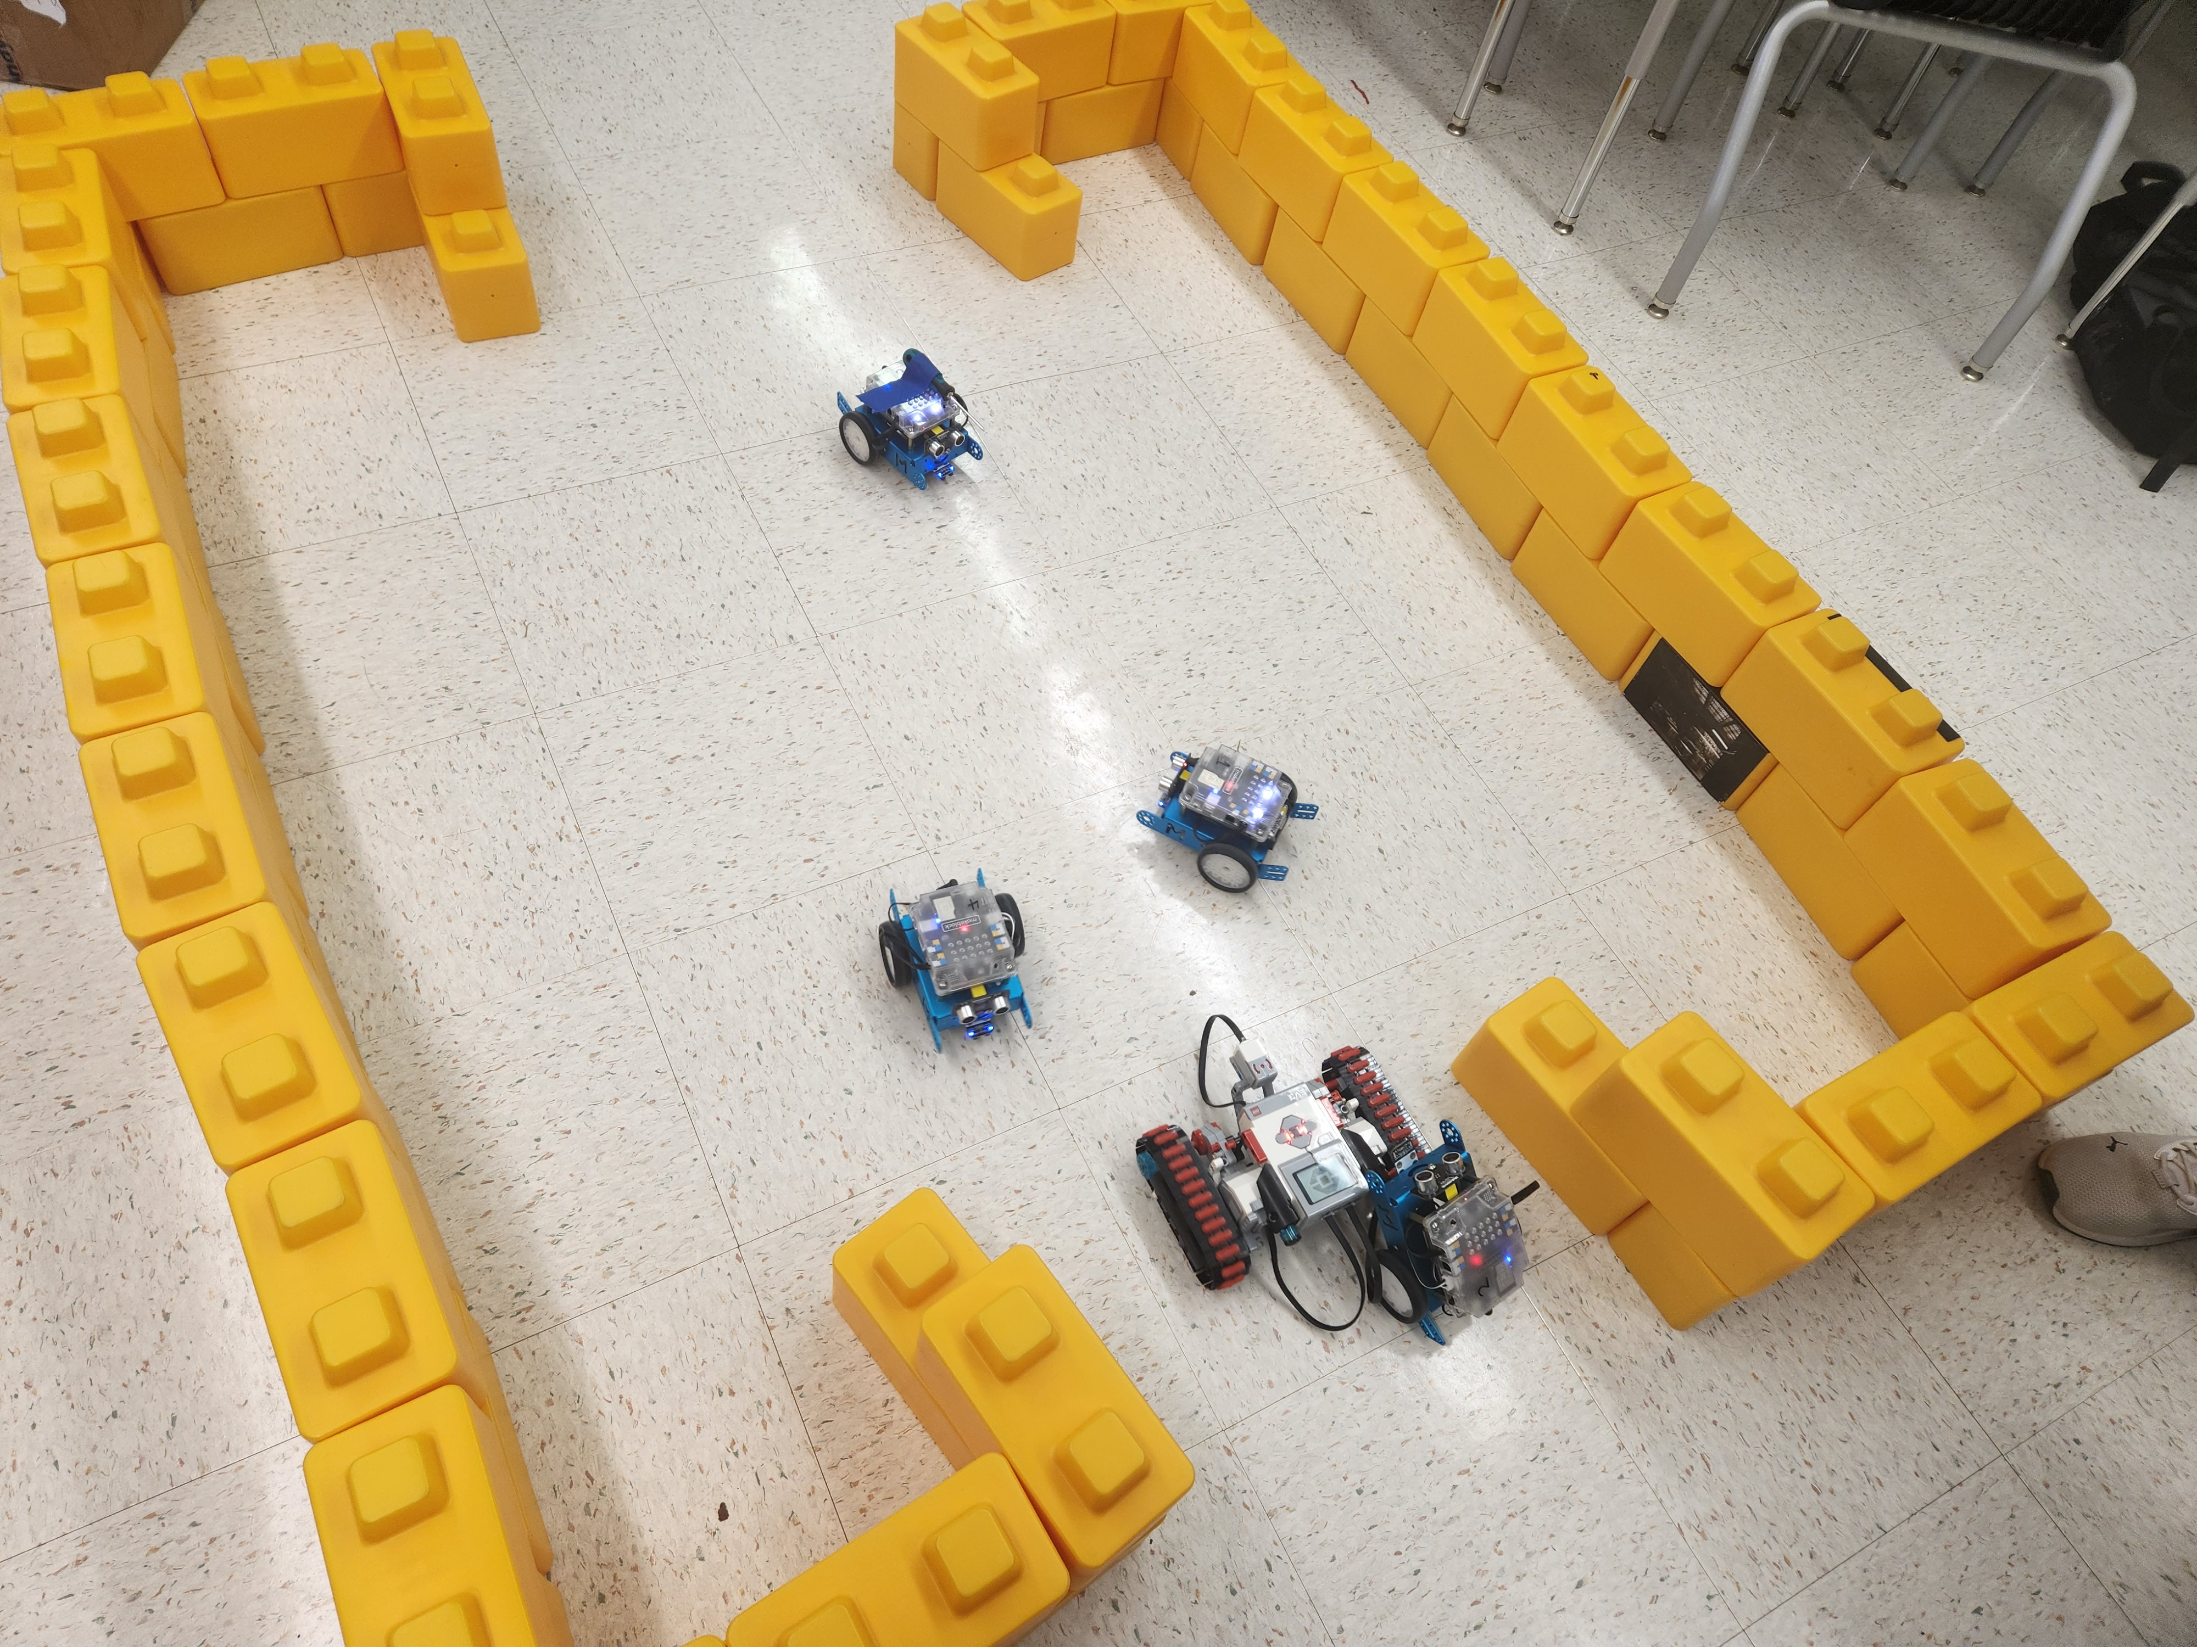
Robotics students assemble xarm 6dof and practice precision controlling makeblock MBOT & LEGO EV3 ROBOTIC KIT

Slide 8
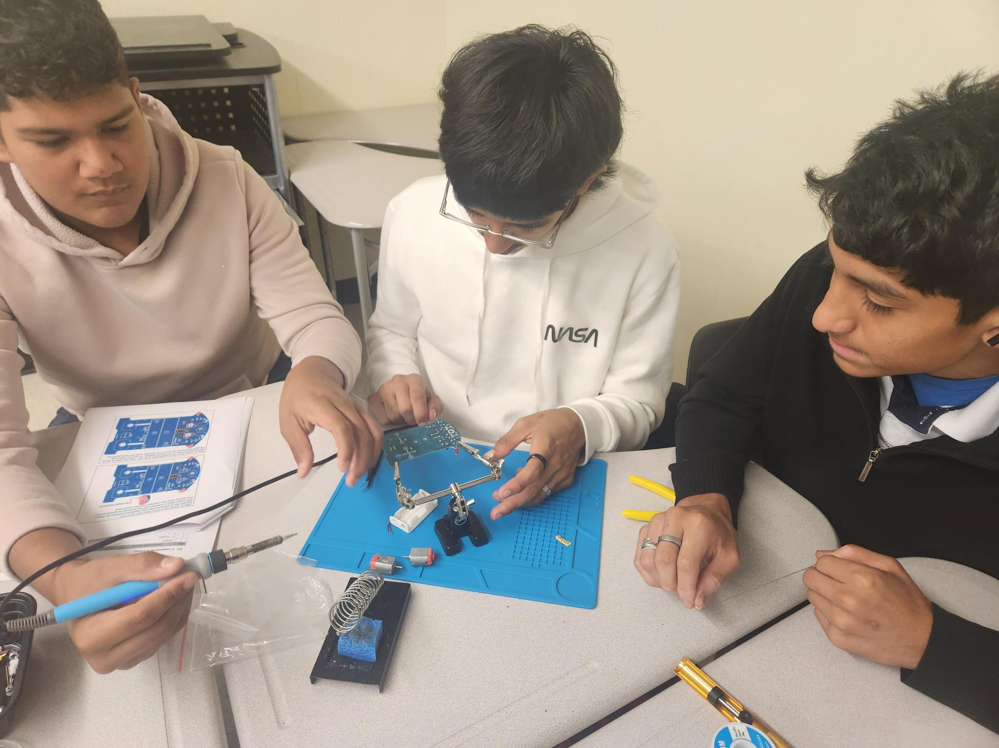
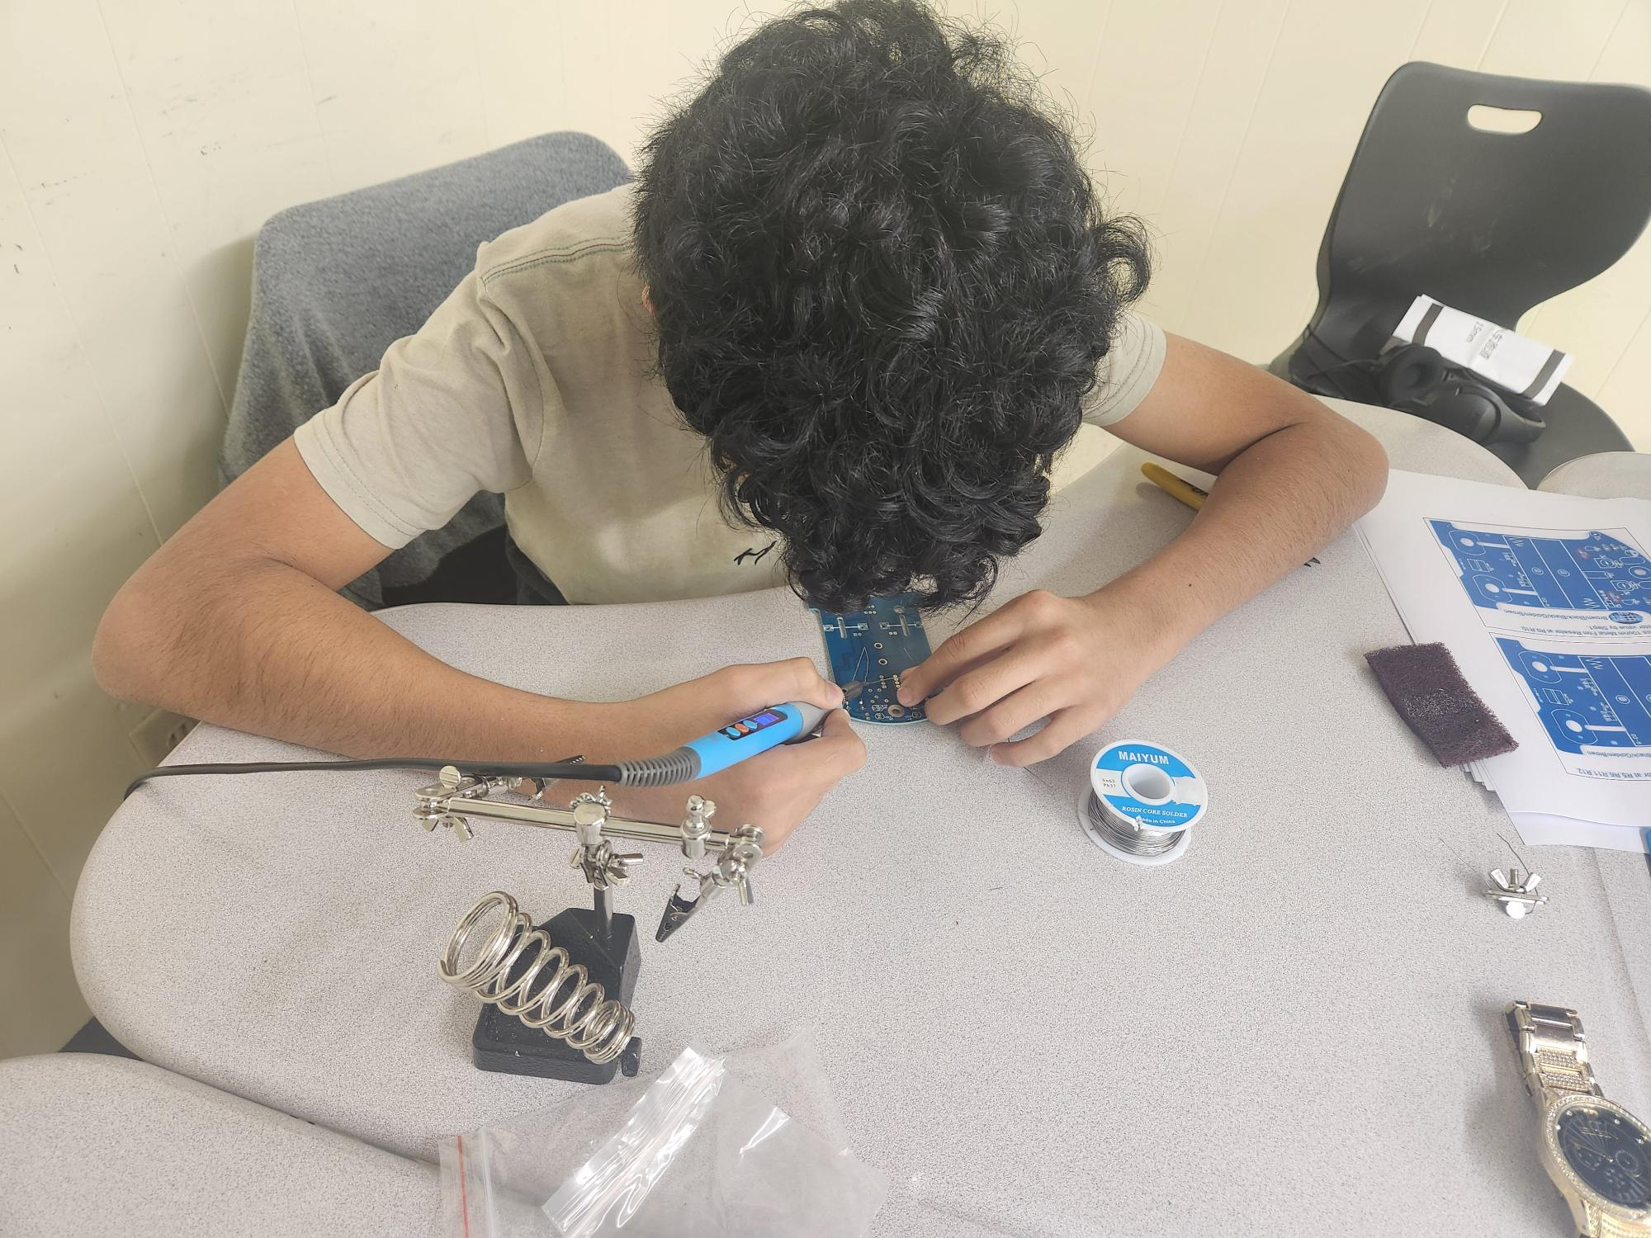
ENGINEERING & ROBOTIC STUDENTS WORK ON SMART TRACKING CAR BUILD PROJECT LEARING ABOUT MECHANICAL STRUCTURES, BASIC ELECTRONICS, READING SCAMATIC DIAGRAMS, AND SENSORS.

Slide 9
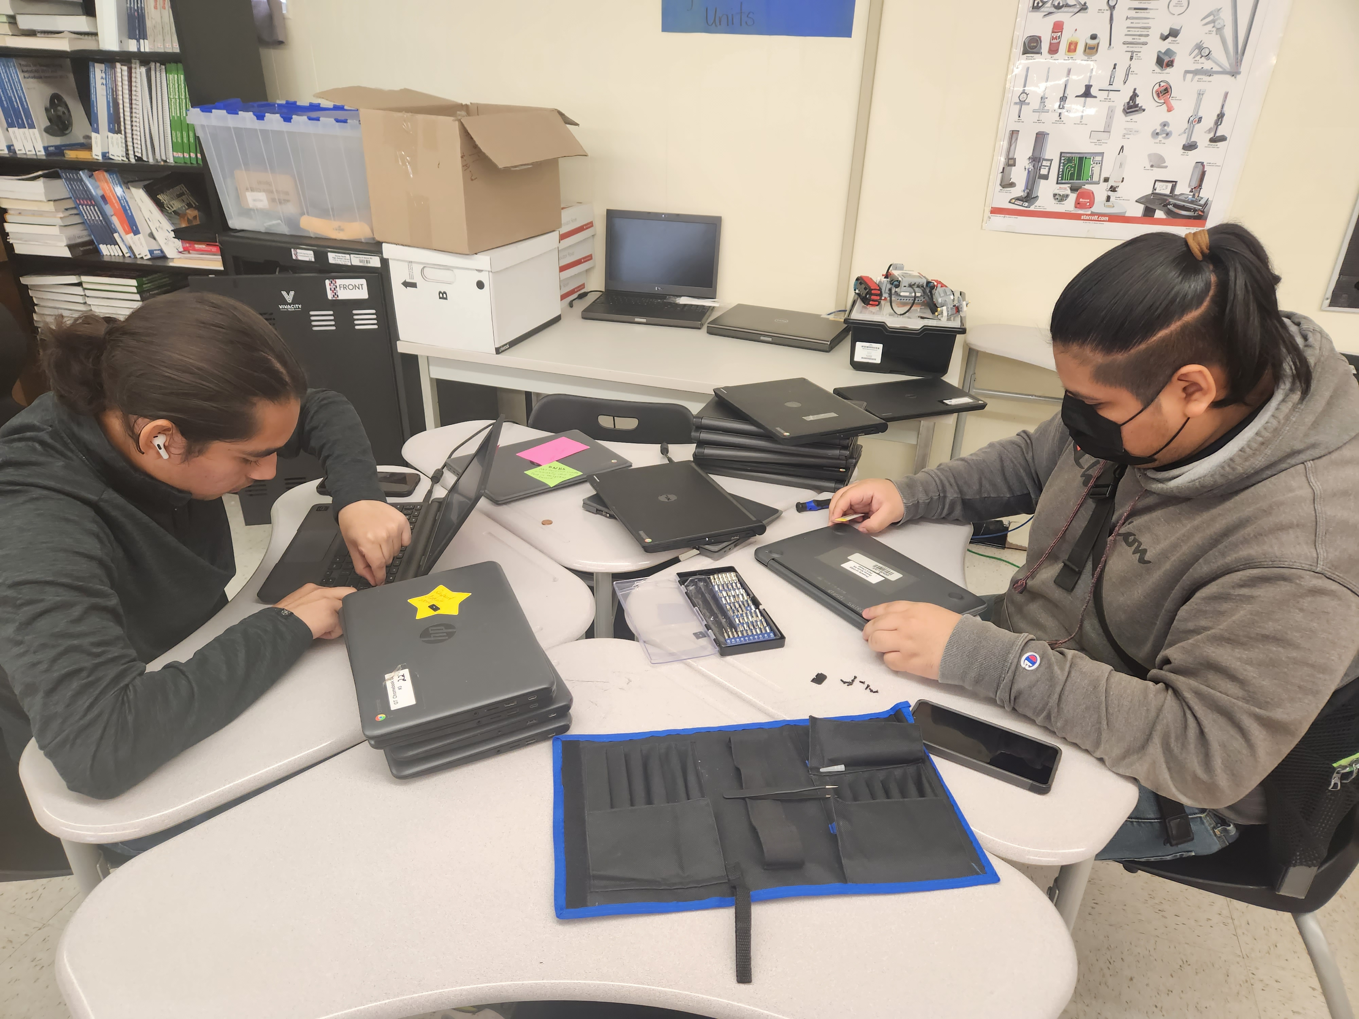
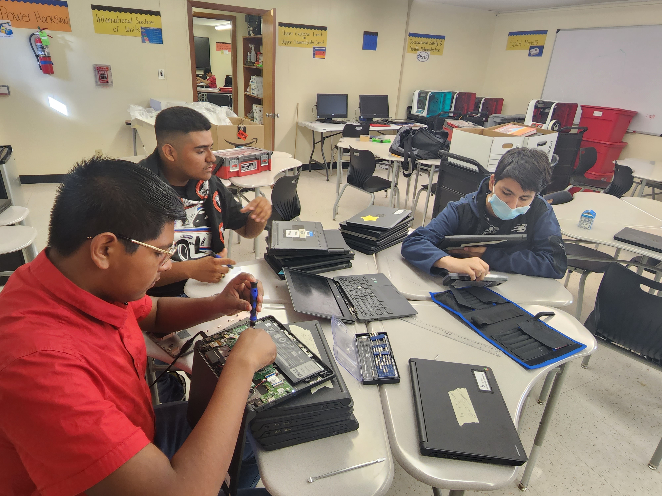
ENGINEERING & ROBOTIC STUDENTS PUT THEIR SKILLS TO WORK FIXING BROKEN CHROMEBOOKS AND KITCHEN APPLICANCES FROM THE LIBRARY AND THE CULINARY LAB. ITEMS are SENT BACK FOR CONTINUED school STUDENt USE.

Slide 10
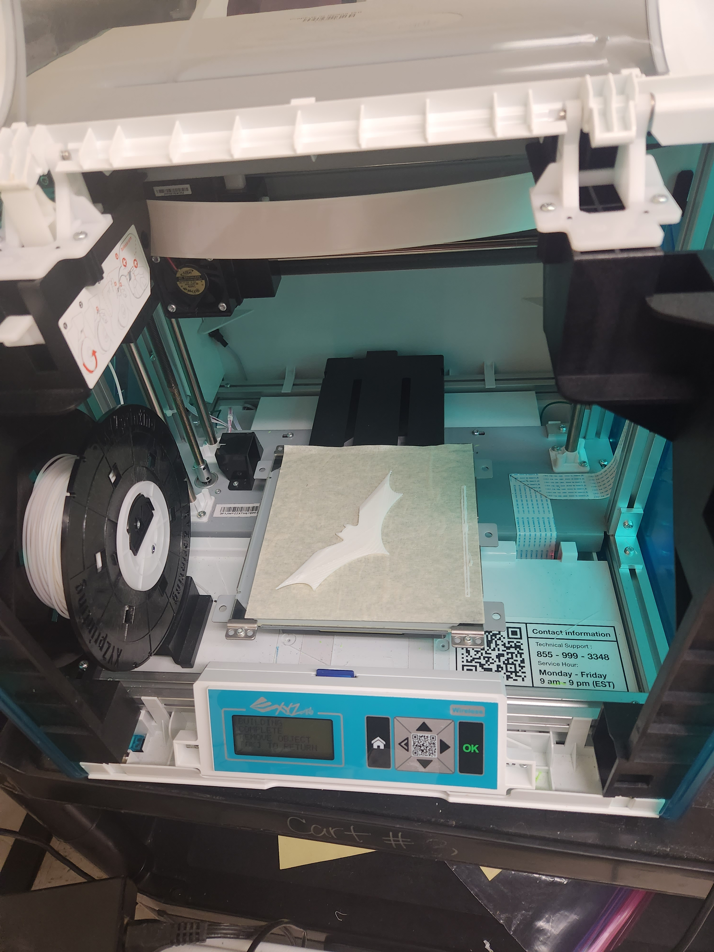
Students work on tetrix robot and use 3d printer

Slide 11
Engineering and robotics students test their smart tracking car build project

Slide 12
Robotics work in progress

